Slide 1

End Term Assessment (checkpoint - 1)
Topic – Demographics Changes Affecting Economic Growth in India
By –
Yash Tiwari 20200802239
Suprabhat Shaurya 20200802166
Hitesh Choudhary 20200802146
Sagar Rajkumar Gupta 20200802112

Slide 2
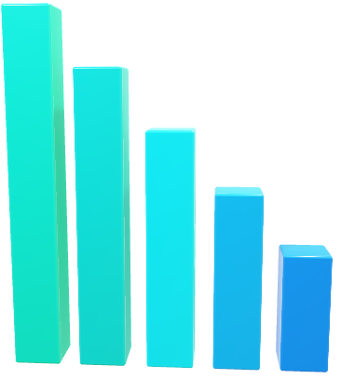
Demographics Changes Affecting Economic Growth in India

Slide 3
Introduction
Demographic change is the study of the changing characteristics of a population, such as its size, age structure, sex ratio, and geographic distribution.
It is a complex and dynamic process that is influenced by a variety of factors, including policies, diversity, migration, and social and economic conditions.
Demographic changes can have a significant impact on society, affecting everything from the economy to the organization.
Analysis of demographic changes is essential for understanding these trends and their implications.
It can help policymakers to develop effective policies and programs to address the challenges and opportunities of demographic changes.

Slide 4
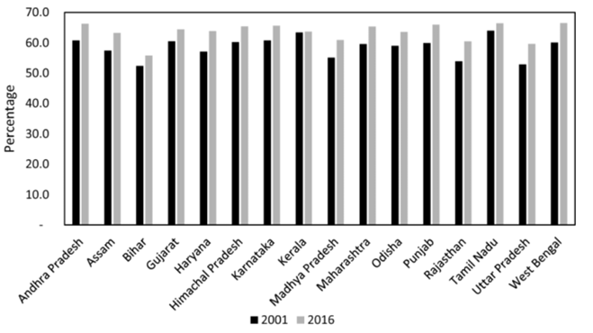
Fertility Rates in Last two decades (2001 , 2016)

Slide 5
Objectives
Diversity & inclusion
Gender And Cultural Barriers
Urbanization and Migration
Youth and Education

Slide 6
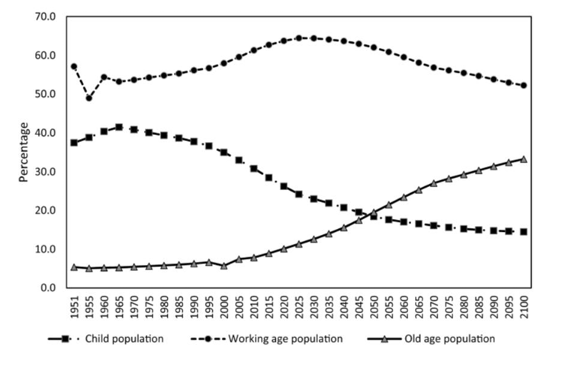
Demographic revolution’ with a shift towards the working-age group in age structure of the population

Slide 7
Why is demographics changes data analysis important?
Demographic changes data analysis is important for a number of reasons.
To understand the current state of the population and to identify trends that may have an impact on the future.
To develop policies and programs that are tailored to the needs of the population.
To identify potential problems and challenges that may arise in the future.

Slide 8
Impacts
Population aging: The global population is aging, with the proportion of people over the age of 65 increasing rapidly. This is due to declining fertility rates and increasing lifespans.
Urbanization and Infrastructure: More and more people are living in cities. This is due to a number of factors, including economic opportunities, better access to education and healthcare, and a desire for a better quality of life.
Migration: People are increasingly moving from one country to another, or from rural to urban areas. This is due to a number of factors, including economic opportunities, political instability, and climate change.
Diversity & Inclusion – Diversity focuses on the demographics of your workplace for instance, gender, race, age while inclusion focuses on efforts towards helping employees with all of those different traits. (feel safe, happy and respected)

Slide 9
Future Trends
Shrinking workforce: Population aging will also lead to a shrinking workforce, as more people retire and fewer young people enter the workforce. This could make it difficult for businesses to find workers and could slow economic growth.
Shift in balance of power: The population shift from developed to developing countries will lead to a shift in the global balance of power and economic influence. Developing countries will become more powerful and influential on the world stage.
Increased pressure on urban infrastructure and services: Urbanization will put increased pressure on urban infrastructure and services, such as housing, transportation, and water and sanitation. This could lead to problems such as overcrowding, traffic congestion, and pollution.
Increased diversity and inclusion: Demographic changes, such as migration and urbanization, can lead to increased diversity and inclusion. This is because they can bring together people from different cultures and backgrounds, which can lead in diversity and inclusion.

Slide 10
Conclusion
Diversity and inclusion are critical for building a sustainable and equitable society.
Urbanization and migration are key drivers of change in the Indian economy.
Data visualization can be a powerful tool for understanding demographic trends.
New technologies are poised to transform the Indian economy.

